Slide 1

Planet Habitability Detection
Isabella Battisti and Tristani Makharashvili
Hartwick College
CISC-315-3B:Data Science with Big Data
Professor Wang
December 8, 2021

Slide 2
Back in September…

Slide 3
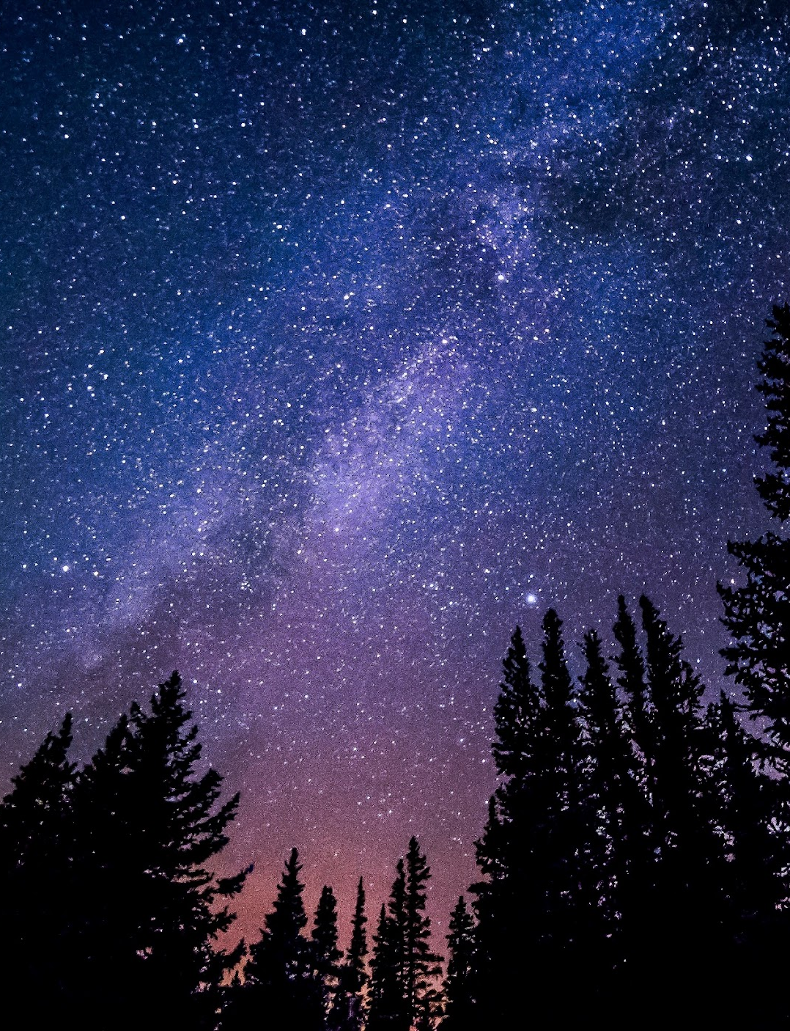
Are we alone?
What is bigger, the universe or the human imagination?
“Two possibilities exist: either we are alone in the Universe, or we are not. Both are equally terrifying.” - Arthur C. Clarke.

Slide 4
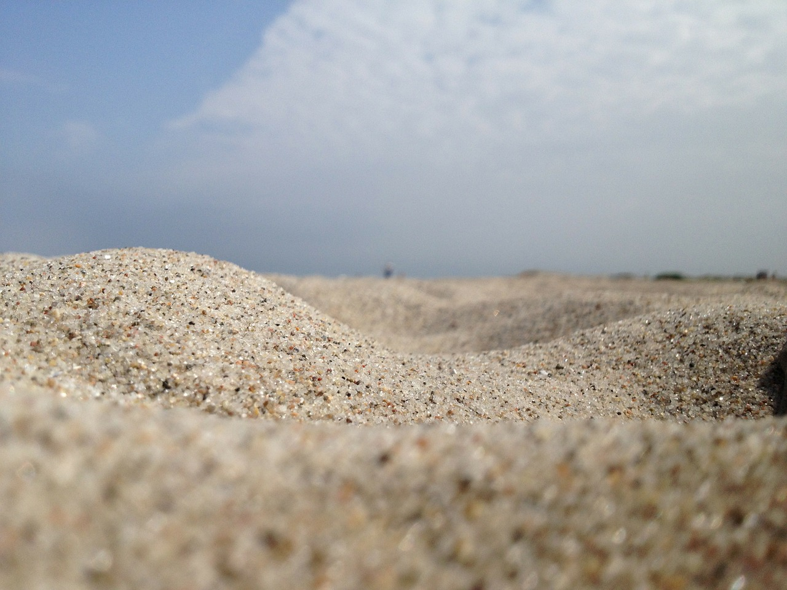

Question for the class:
What do you think,
how many grains of sand are there on the Earth?

Slide 5
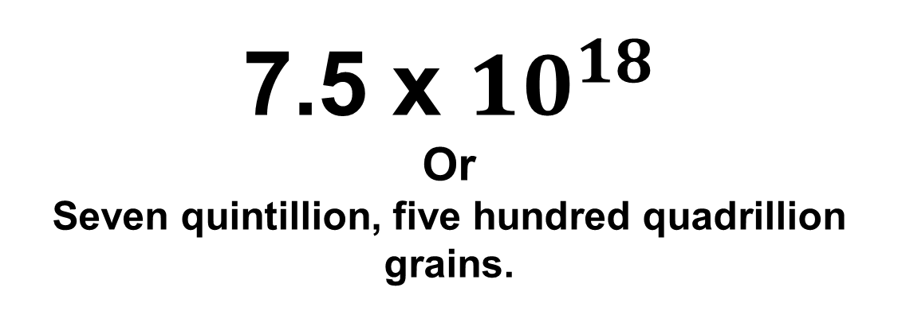
Question for the class:
What do you think,
how many grains of sand are there on the Earth?

Slide 6
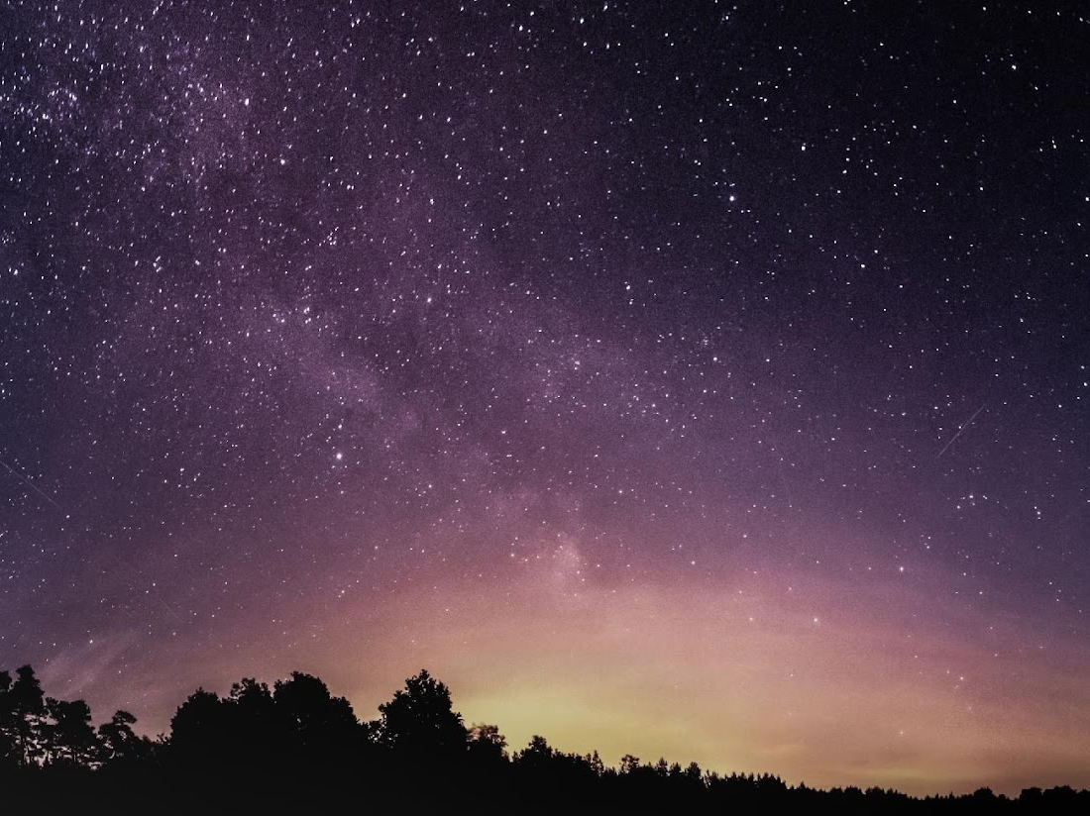
What if I told you…
That there are more stars in the universe than grains of sand on Earth?

Slide 7
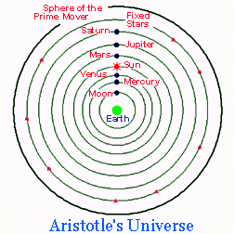
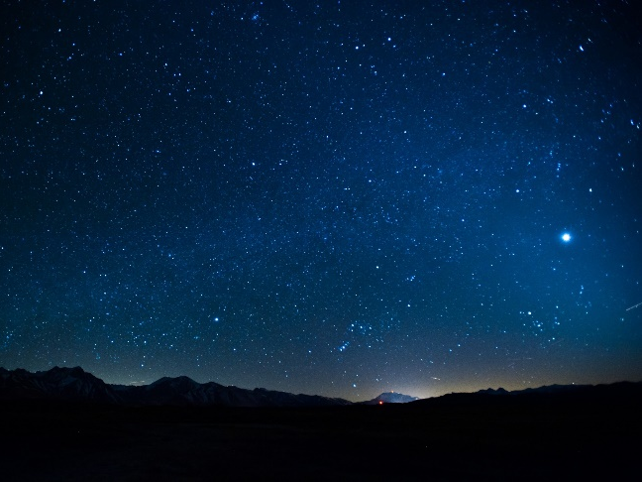
History
The Ancient Greeks developed astronomy, which they treated as a branch of mathematics, to a highly sophisticated level.
Aristotle was one of the greatest philosophers who has ever lived. However, he got one thing terribly wrong.
After almost 200 hundred years Galileo proved that the Earth was orbiting Sun.

Slide 8

Key Point
What we once thought was true quickly fades away upon closer inspection.
Without a doubt science is changing and will continue to change as we explore more of our knowledge

Slide 9

Why this project? Why not?
Planet Habitability Detection from data
We live in the 21st century - the era of technology.
In last couple of decades, we have made amazing discoveries.
Discovery of gravitational waves
We constructed the first image of a black hole
We are spending billions to build gigantic telescopes
We receive huge amounts of data daily
The universe is cool

Slide 10
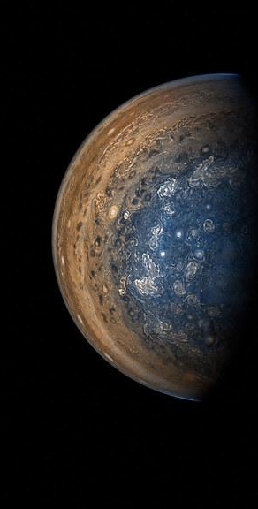
We used two open-source datasets
NASA exoplanet catalog (NASA Exoplanet Archive, n.d.)
Planetary Habitability Laboratory, also known as PHL, from Kaggle (PHL Exoplanet Catalog | Kaggle, n.d.).

Slide 11
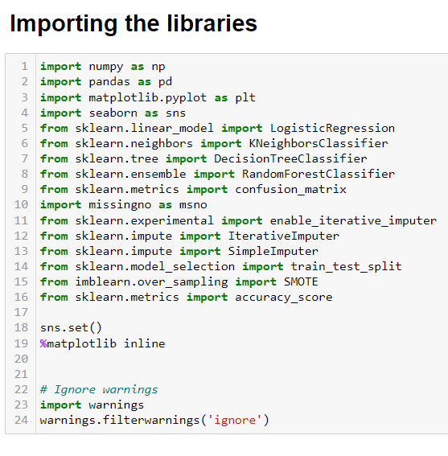
Setup
Representation:
Matplotlib
Seaborn
Missingno
Data Pre-Processing & Handling missing data
sklearn
Ignore Warnings
warnings
We will explain how we used them as we go through.

Slide 12
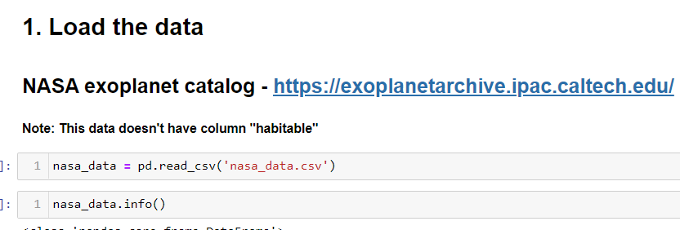
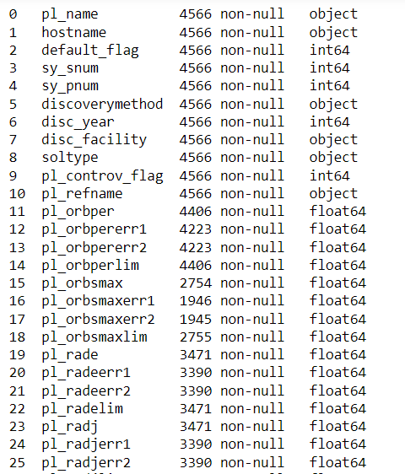
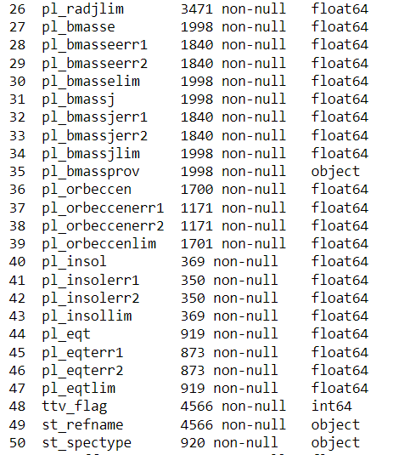
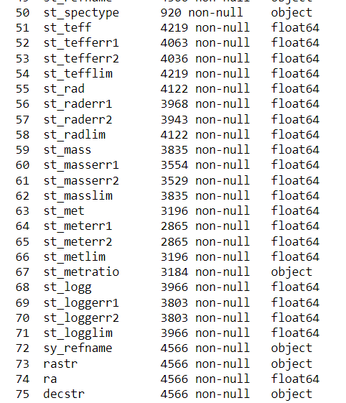
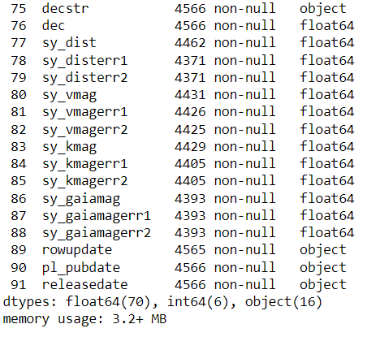
NASA exoplanet Catalog Note: This dataset doesn’t have column “habitable”
This data is messy. There are lots of missing values.

Slide 13
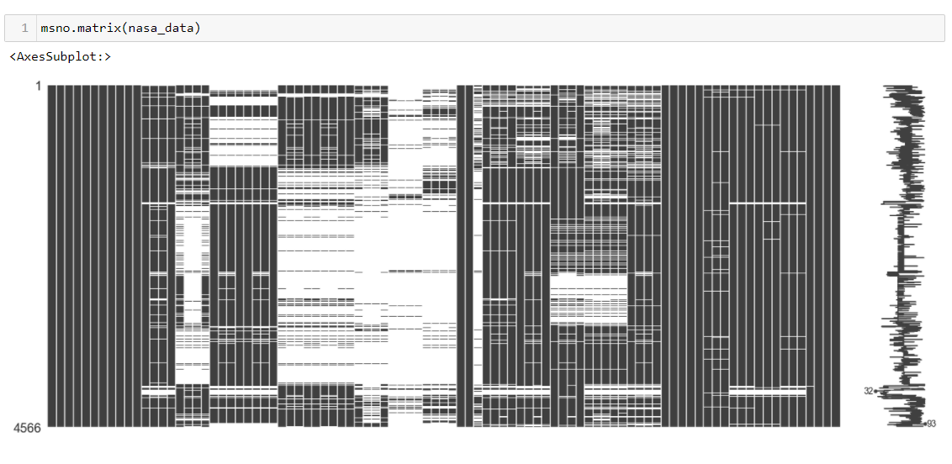
Null values in the NASA exoplanet catalog
Note: White spaces represent null values

Slide 14
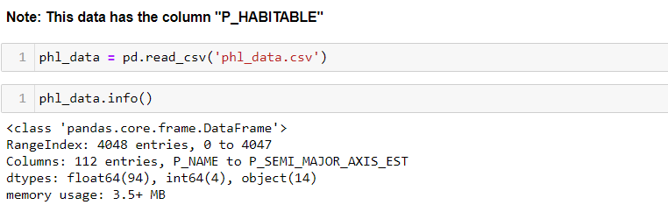
PHL (Planetary Habitability Laboratory) data. Note: This dataset has a column “P_HABITABLE”

Slide 15
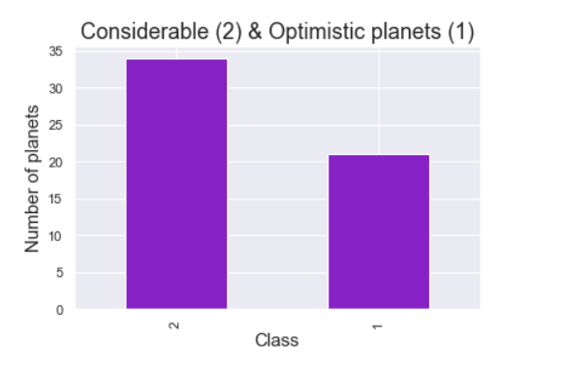
Visualization & EDA
New column “habitable” in NASA dataset
We dropped all non-habitable planets from PHL dataset. We were left with only habitable.
These habitable planets are also in NASA dataset.
We added a new column “habitable” for NASA dataset.
In this way, we would have a target variable in the NASA dataset.

Slide 16
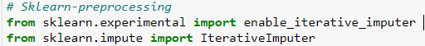


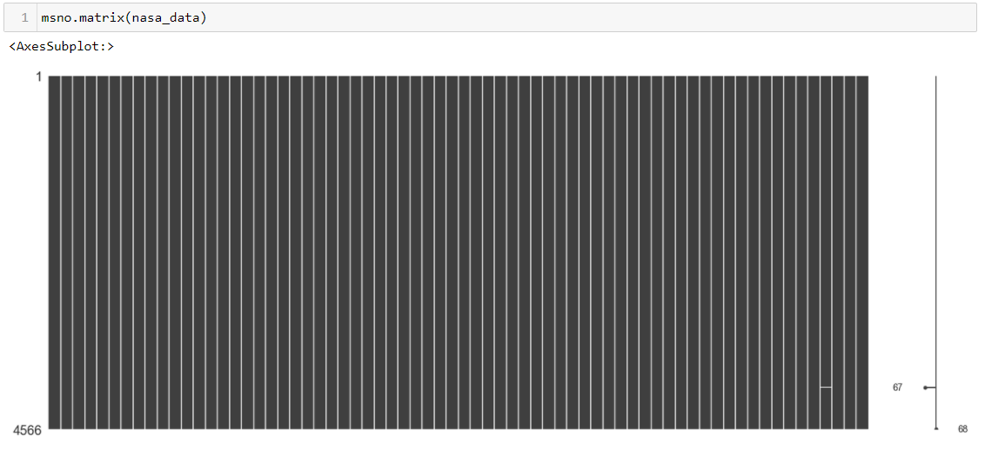
Visualization & EDA
What about all of these missing values?
Iterative Imputer
Datasets may have missing values, and this can cause problems for many machine learning algorithms.
“Iterative imputation, in which variables are imputed one at a time conditional on all the others, is a popular technique that can be convenient and flexible, as it replaces a potentially difficult multivariate modelling problem with relatively simple univariate regressions.” (Liu et al., 2014)
Before
After

Slide 17
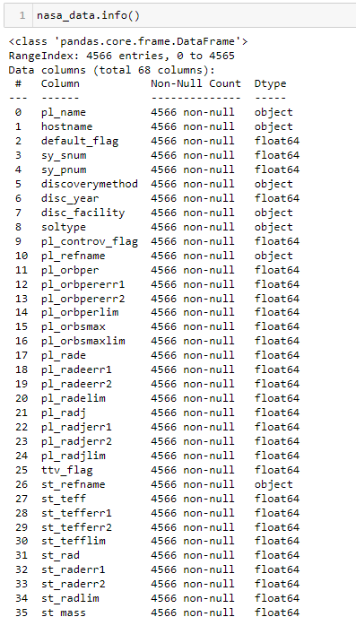
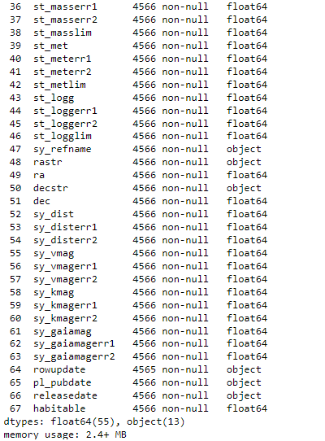
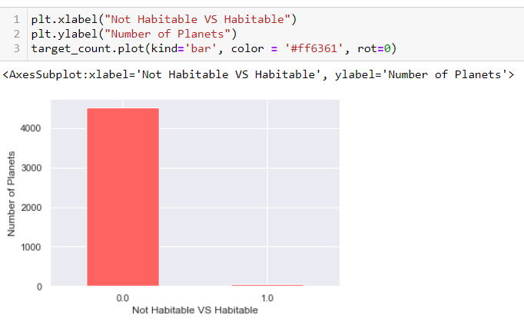
Visualization & EDA
Target value distribution

Slide 18
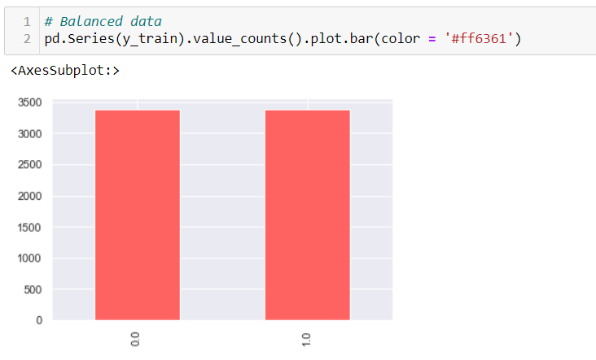



Imbalanced data SMOTE for imbalanced classification Source: Cornell University - https://arxiv.org/abs/1106.1813
Before:
After:
A dataset is imbalanced if the classification categories are not approximately equally represented.
“The performance of machine learning algorithms is typically evaluated using predictive accuracy. However, this is not appropriate when the data is imbalanced and/or the costs of different errors vary markedly.”(Chawla et al., 2002)
“Combination of our method of over-sampling the minority class and under-sampling the majority class can achieve better classifier performance than only under-sampling the majority class.” (Chawla et al., 2002)

Slide 19
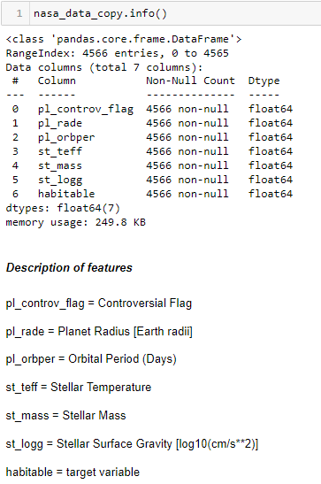
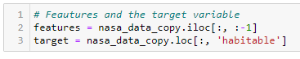
Heading to machine learning
We have features and target variable - habitable
Why these features?
Radius & Mass & gravity – atmosphere, gravitational field, liquid water on the surface.
Stellar temperature – liquid water on the surface
Orbital period – to achieve a suitable temperature. It has to be stable.

Slide 20
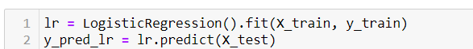
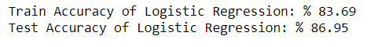
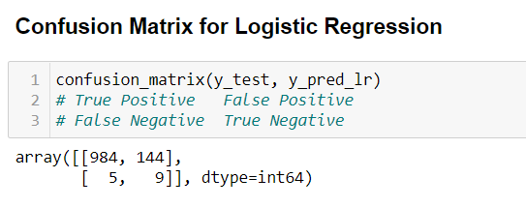
Machine Learning Algorithms
Split the data
First:
Logistic Regression

Slide 21
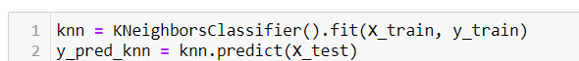
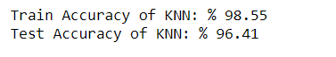
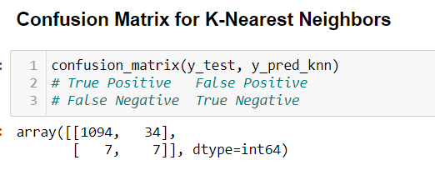
Machine Learning Algorithms
Second:
K-Nearest Neighbors

Slide 22
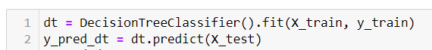
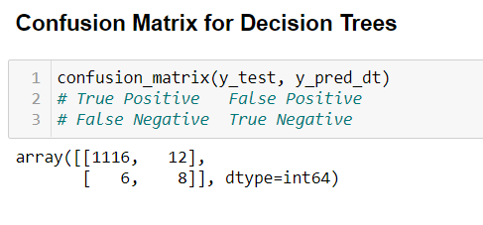
Machine Learning Algorithms
Third:
Decision Trees

Slide 23
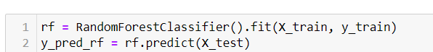
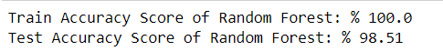
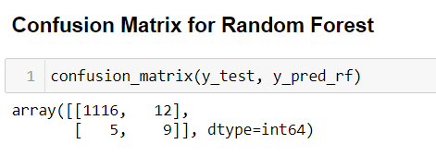
Machine Learning Algorithms
Fourth:
Random Forest

Slide 24
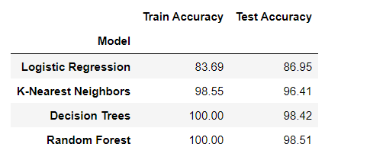
Final Results

Slide 25
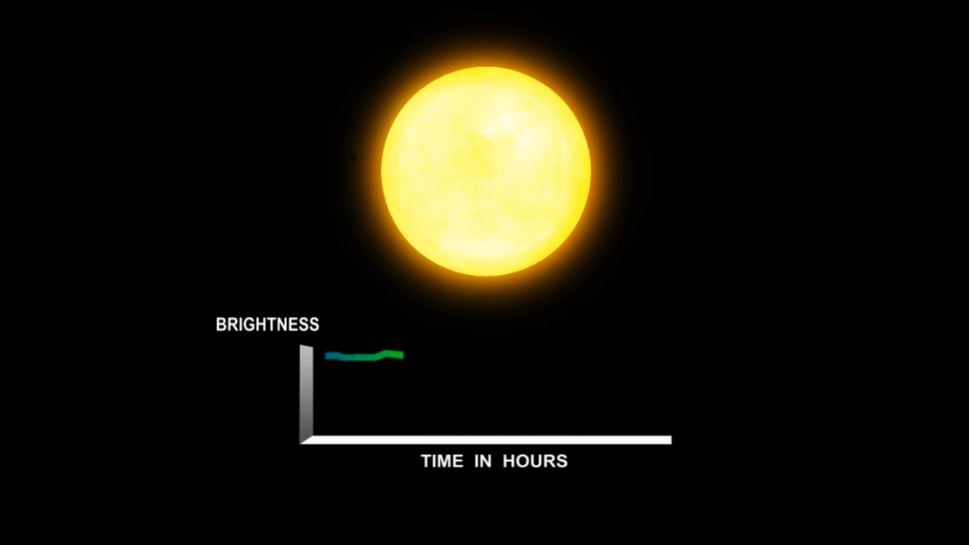
NASA:
https://www.youtube.com/watch?v=8v4SRfmoTuU&t=9s
Transit Method for detecting planets

Slide 26
Q & A

Slide 27

References
Chawla, N. v, Bowyer, K. W., Hall, L. O., & Kegelmeyer, W. P. (2002). SMOTE: Synthetic Minority Over-sampling Technique. In Journal of Artificial Intelligence Research (Vol. 16).
Liu, J., Gelman, A., Hill, J., Su, Y. S., & Kropko, J. (2014). On the stationary distribution of iterative imputations. Biometrika, 101(1), 155–173. https://doi.org/10.1093/biomet/ast044
NASA Exoplanet Archive. (n.d.). Retrieved December 4, 2021, from https://exoplanetarchive.ipac.caltech.edu/
PHL Exoplanet Catalog | Kaggle. (n.d.). Retrieved December 4, 2021, from https://www.kaggle.com/chandrimad31/phl-exoplanet-catalog

Slide 28

Thank you

